Slide 1
Engin Oral, M.D.
Istanbul Univ. Cerrahpasa Medical Faculty
Dept. of Obstet & Gynecol
drenginoral@gmail.com

Slide 2
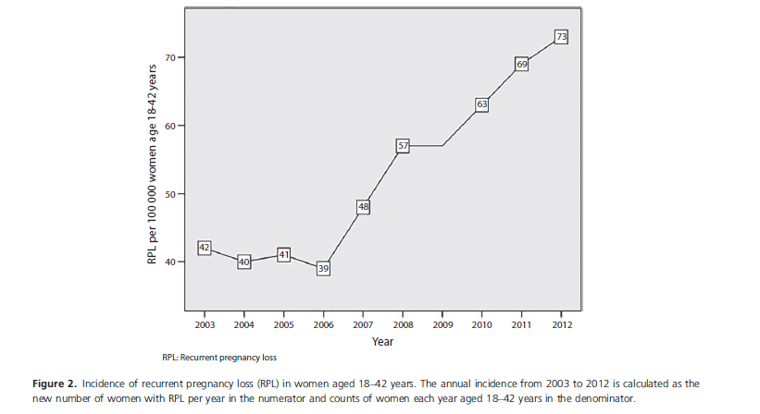
2017
The prevalence of RPL defined as three or
more consecutive miscarriages before gestation week 22,
Notes:
Introduction. The aim of this study was to estimate the incidence of
recurrent pregnancy loss (RPL). The prevalence of RPL defined as three or
more consecutive miscarriages before gestation week 22, is often stated to be
1%. To our knowledge no study has estimated the incidence of RPL, which
might be more informative and clinically relevant than the prevalence.
Material and methods. This retrospective register-based study was conducted
from 2003 until 2012 in Sweden with data provided by the Swedish National
Board of Health and Welfare. In all, 6852 women were registered with the
diagnoses of RPL in the National Patient Register. The incidence of RPL is
the number of new women receiving the RPL diagnosis per year in the
numerator and population at risk in the denominator. Results. For each year,
from 2003 to 2012, the incidence was calculated in two different risk
populations: [1] all women aged 18–42 years, and [2] all women registered
as being pregnant (deliveries or miscarriages). The average incidence in the
study period was 53 per 100 000 (0.05%) in women aged 18–42 years and
650 per 100 000 (0.65%) in women who had achieved pregnancy in the
period. The incidence of RPL in the two risk populations increased by 74
and 58%, respectively, during the study period. Conclusion. This study
suggests that the incidence of RPL increased during the 10-year period
studied. Causes can only be speculated upon in this study design, but might
be associated with environmental changes, as the increase was fairly rapid.

Slide 3
Definition of RPL
A diagnosis of Recurrent Pregnancy Loss (RPL) could be considered after the loss of two or more pregnancies.
A pregnancy in the definition is confirmed at least by either serum or urine b-hCG, i.e. including non-visualized pregnancy losses (biochemical pregnancy losses and/or resolved and treated pregnancies of unknown location)
Ectopic and molar pregnancies are not included
Pregnancy losses both after spontaneous conception and after ART treatments should be included in the definition
Primary RPL is described as RPL without a previous ongoing pregnancy (viable pregnancy) beyond 24 weeks’ gestation, while secondary RPL is defined as an episode of RPL after one or more previous pregnancies progressing beyond 24 weeks’ gestation.
Recurrent “Early” Pregnancy Loss (REPL) is the loss of two or more pregnancies before 10 weeks of gestational age
Prevalence of RPL is between 0.8-1.4% if only clinical miscarriages (confirmed by ultrasound and/ or histology) are included; adding biochemical losses increases the prevalence to 2% to 3%

Slide 6
Risk factors
Women should be sensitively informed that the risk of pregnancy loss is lowest in women aged 20 to 35 years.
Women should be sensitively informed that the risk of pregnancy loss rapidly increases after the age of 40.
Stress is associated with RPL, but couples should be informed that there is no evidence that stress is a direct cause of pregnancy loss
Couples with RPL should be informed that smoking, maternal obesity or being significantly underweight excessive alcohol consumption could have a negative impact on their chances of a live birth

Slide 7
Investigations in RPL
Medical and family history could be used to tailor diagnostic investigations in RPL
Information on previous diagnosis of medical conditions that may be associated with RPL, including thrombophilia, PCOS, and diabetes, or a family history of hereditary thrombophilia should be collected

Slide 8
some diagnostic tests, although not recommended for all couples, can be relevant only in selected RPL couples, for instance:
- prolactin testing in women with clinical symptoms of hyperprolactinemia (oligo-amenorrhea)
- HLA class II determination in women with secondary RPL after the birth of a boy
- sperm DNA fragmentation assessment can be more relevant in males with unhealthy lifestyles
(smoking, alcohol, excessive exercise, unhealthy body weight)

Slide 9
parental karyotyping is less relevant in couples with female age above 39, less than 3 pregnancy losses and a negative family history, as in these couples the chance of being a carrier of a translocation is very low (below 2.2 %)
Female age and number of previous losses are the only known factors consistently shown to impact prognosis

Slide 10
Screening for genetic factors
Aneuploidies occur in comparable frequencies in both women with sporadic and recurrent pregnancy loss
Determining the chromosomal status of pregnancy tissue from women with recurrent pregnancy loss may provide them with a cause or reason for the particular loss being investigated, but it does not necessarily rule out other underlying conditions.
No clear effect of genetic testing of the pregnancy tissue on prognosis (subsequent live birth) has been described so far
Genetic analysis of pregnancy tissue is not routinely recommended but it could be performed for explanatory purposes
The preferred method of genetic analysis is array-CGH, as this is not limited by tissue culture failure or false negative results due to maternal cell contamination.

Slide 11
2018

Slide 12
PARENTAL GENETIC ANALYSIS
Parental karyotyping is not routinely recommended in couples with RPL
It could be carried out after individual assessment of risk: previous birth of a child with cong. abnormality, translocation in the pregnancy tissue, child with unbalanced chromosome abn.
Parental karyotyping may provide couples with a possible contributing factor and prognostic information for the subsequent pregnancy.

Slide 13
Regarding prognosis, couples should be informed that, even if a parental abnormality is found after karyotyping, the cumulative live birth rates are good, as are the chances of a healthy child, despite a higher risk of a subsequent pregnancy loss.
They should be informed of the limitations of karyotyping, including that karyotyping does not predict unbalanced translocation in next pregnancy.

Slide 14
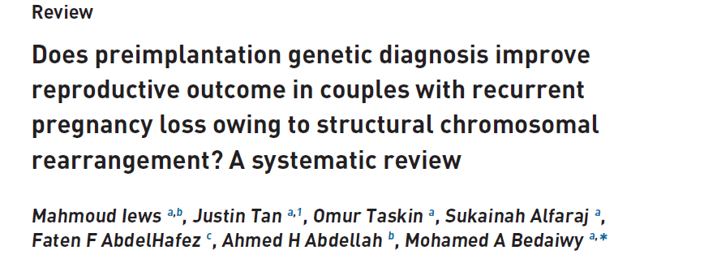
2018

Slide 15
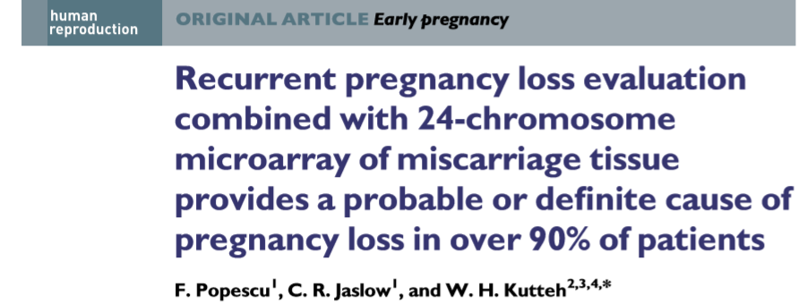
2018

Slide 16
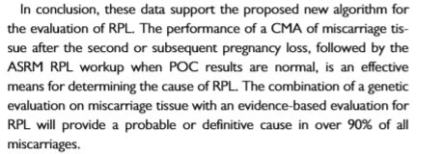

Slide 17
HEREDITARY THROMBOPHILIA
There is no, or at best a weak, association between RPL and hereditary thrombophilia
A significant association between the factor V Leiden (F5 c.1691G>A) genotype and RPL (OR 2.02; 95% CI 1.60-2.55; based on 33 case- control studies), and between the factor V Leiden mutation and the risk of a pregnancy loss in the next pregnancy (OR 1.93; 95% CI 1.21–3.09; based on 4 prospective cohort studies).
Carriers of the Factor V Leiden mutation were more likely to have a subsequent loss as compared to non-carriers (OR 2.03; 95% CI 1.29-3.17; based on eight cohort studies)

Slide 18
With regard to the clinical utility, the reviewers concluded that a positive test result was not associated with improved outcomes for the couples based on the lack of an effect of treatments on pregnancy outcome
In addition, there were several harms in testing, including anticoagulant-related maternal risks, costs, and unneeded treatment after a false-positive results

Slide 19
ACQUIRED THROMBOPHILIA
Testing for aPL antibodies can provide a possible cause of the PL, and treatment in the next pregnancy can prevent antiphospholipid syndrome (APS)-associated pregnancy complications.
Based on a study showing treatment can improve LBR in women with RPL and aβ2GPI, screening can be considered

Slide 20
Thrombophilia Screening
For women with RPL, it is suggested not to screen for hereditary thrombophilia except for women with additional risk factors for thrombophilia
For women with RPL, it is recommended to screen for antiphospholipid antibodies (Lupus Anticoagulant [LA], and Anticardiolipin antibodies [ACA IgG and IgM]), after two pregnancy losses.
For women with RPL, screening for β2 glycoprotein I antibodies (aβ2GPI) can be considered after two pregnancy GPP losses
Measurement of homocysteine plasma levels is not routinely recommended in women with RPL.

Slide 21
2016

Slide 22
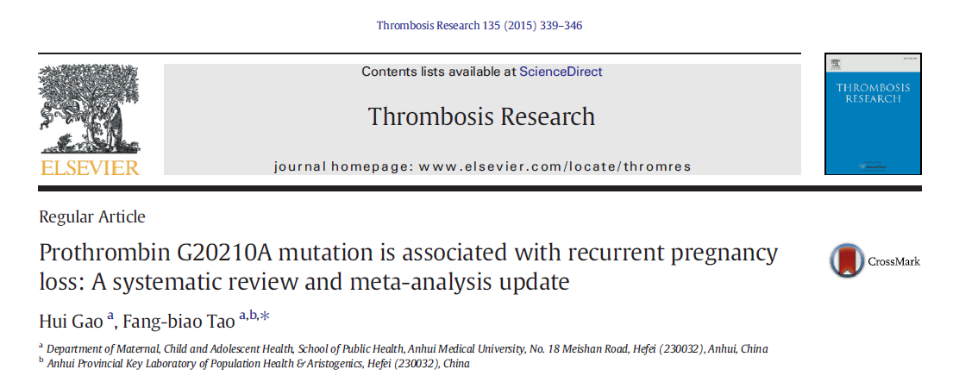
2015
A significant association was found between G20210A and RPL, with a combined odds ratio (OR) of 1.81 (95% confidence interval [CI]: 1.26-2.60).
Notes:
Background: Thrombophilia is reported to be a candidate etiology of recurrent pregnancy loss (RPL). No
conclusive results on the association between prothrombin G20210A mutation and RPL have been reported.
Methods:Weundertook a systematic reviewandmeta-analysis of 37 case-control studies using a comprehensive
electronic search on papers published by May 2014.We studied 5400 cases and 4640 controls to investigate the
potential association between G20210A and RPL. In this review, we define RPL as more than 2 miscarriages.
Results: A significant association was found between G20210A and RPL, with a combined odds ratio (OR) of 1.81
(95% confidence interval [CI]: 1.26-2.60). However, the risks differed in the subgroup analyses, categorized by
study sites, maternal age, and type of miscarriages. The pooled OR remained significant in European studies
(OR: 1.80, 95% CI: 1.35-2.41), whereas in the Middle-Eastern studies, it was not significant (OR: 2.39, 95% CI:
0.96-5.92). The risk of RPL was significantly higher in women older than 29 years (OR: 1.91, 95% CI: 1.61-
6.11), and a positive relationship was only observed between prothrombin G20210A mutation and fetal loss,
but not embryonic loss. There was no evidence of publication bias in any of the analyses. The sensitivity analyses
showed that the findings were quite stable.
Conclusion: This meta-analysis suggests that the G20210A prothrombin mutation increases the risk of RPL (fetal
loss, primary RPL, or secondary RPL), particularly in Europeans and women older than 29 years. We recommend
further screening in more specific groups amongwomen.

Slide 23
2018
2013
2012
2011
Notes:
[37] Toth B, Würfel W, Bohlmann MK et al. Recurrent miscarriage: diagnostic
and therapeutic procedures. Guideline of the DGGG (S1-Level, AWMF
Registry No. 015/050, December 2013). Geburtsh Frauenheilk 2015;
75: 1117–1129
[38] Bates SM, Greer IA, Middeldorp S et al. VTE, thrombophilia, antithrombotic
therapy, and pregnancy: Antithrombotic Therapy and Prevention
of Thrombosis, 9th ed: American College of Chest Physicians Evidence-
Based Clinical Practice Guidelines. Chest 2012; 141: e691S–e736S
[39] Gynaecologists, RCOG. The investigation and treatment of couples with
recurrent firsttrimester and second-trimester miscarriage. RCOG Greentop
Guideline No. 17, 2011. Last update April 2011. Online: www.nice.
org.uk/accreditation

Slide 24
Immunological testing
Human Leukocyte Antigen (HLA) determination in women with RPL is not recommended in clinical practice.
Cytokine testing should not be used in women with RPL in clinical practice
There is insufficient evidence to recommend Natural Killer (NK) cell testing of either peripheral blood or endometrial tissue in women with RPL

Slide 25
Antinuclear antibodies (ANA) testing could be considered for explanatory purposes
Majority of case-control studies document an association to RPL and there is some evidence that ANA presence affects the prognosis negatively
Whether ANA positivity can identify a subset of women with RPL that responds beneficially to various forms of immunotherapy is unknown and can only be shown in randomized controlled trials.

Slide 26
Metabolic and endocrinologic factors
Prolactin testing is not recommended in women with RPL in the absence of clinical symptoms of hyperprolactinemia (oligo/amenorrhea).
Androgen testing is not recommended in women with RPL.
Luteal phase insufficiency testing is not recommended in women with RPL.
Luteinizing Hormone (LH) testing is not routinely recommended in women with RPL
Ovarian reserve testing is not routinely recommended in women with RPL
Measurement of homocysteine plasma levels is not routinely recommended in women with RPL.

Slide 27
Vit D
Even though one study showed a significant prevalence of vitamin D deficiency in women with RPL, there are no indications that vitamin D status is a contributing factor for RPL.
there is no report of an association between vitamin D status and miscarriage, and hence testing of vitamin D status is not recommended for women with RPL

Slide 28
Endocrinologic Factors
Thyroid screening (Thyroid stimulating hormone [TSH] and Thyroid peroxidase [TPO]-antibodies) is recommended in women with RPL.
Abnormal TSH and TPO-antibody levels should be followed up by T4 testing in women with RPL.
No studies were found that described or searched for an association between hyperthyroidism and recurrent pregnancy loss (RPL).

Slide 30
PCOS AND DISTURBANCES OF THE INSULIN METABOLISM
Assessment of polycystic ovary syndrome (PCOS), fasting insulin and fasting glucose is not recommended in women with RPL to improve next pregnancy prognosis.
Insulin resistance is shown to be more prevalent in women with a history of RPL than in women without RPL.
The mechanism of how insulin resistance can result in pregnancy loss is unknown.
There are no studies on the prognostic potential.

Slide 32
Male Factors
A meta-analysis showed a significant increase in miscarriage rates in men with high sperm DNA damage compared with those with low sperm DNA damage (RR 2.16; 95% CI 1.54-3.03).
In the male partner, it is suggested to assess life style factors (smoking, alcohol consumption, exercise pattern, and body weight)
Assessing sperm DNA fragmentation in couples with RPL can be considered for explanatory purposes, based on indirect evidence

Slide 33
Anatomy
All women with RPL should have an assessment of the uterine anatomy
The preferred technique to evaluate the uterus is transvaginal 3D ultrasound (US), which has a high sensitivity and specificity, and can distinguish between septate uterus and bicorporeal uterus with normal cervix
Sonohysterography (SHG) is more accurate than hysterosalpingography (HSG) in diagnosing uterine malformations. It can be used to evaluate uterine morphology when 3D ultrasound (US) is not available, or when tubal patency has to be investigated
MRI is not recommended as first line option for the assessment of uterine malformations in women with RPL, but can be used where 3D US is not available.
If a Müllerian uterine malformation is diagnosed, further investigation (including investigation of the kidneys and urinary tract) should be considered.

Slide 34
Treatment for RPL with genetic background
All couples with results of an abnormal fetal or parental karyotype should receive genetic counselling
All couples with results of an abnormal fetal or parental karyotype may be informed about the possible treatment options available including their advantages and disadvantages.

Slide 35
Treatment for RPL and Thrombophilia
For women with hereditary thrombophilia and a history of RPL, we suggest not to use antithrombotic prophylaxis unless in the context of research, or if indicated for venous thromboembolism (VTE) prevention

Slide 36
TREATMENT FOR WOMEN WITH RPL AND ANTIPHOSPHOLIPID SYNDROME (APS)
For women who fulfill the laboratory criteria of APS and a history of three or more pregnancy losses, we suggest administration with low-dose aspirin (75 to 100 mg/day) starting before conception, and a prophylactic dose heparin (Unfractionated heparin [UFH] or Low molecular weight heparin [LMWH]) starting at date of a positive pregnancy test, over no treatment
The GDG suggests offering anticoagulant treatment for women with two pregnancy losses and APS, only in the context of clinical research.

Slide 37
TREATMENT FOR THYROID ABNORMALITIES ASSOCIATED WITH RPL
Overt hypothyroidism arising before conception or during early gestation should be treated with levothyroxine in women with RPL.
There is conflicting evidence regarding treatment effect of levothyroxine for women with subclinical hypothyroidism (SCH) and RPL.
Treatment of women with SCH may reduce the risk of miscarriage, but the potential benefit of treatment should be balanced against the risks.
If women with subclinical hypothyroidism and RPL are pregnant again, thyroid stimulating hormone (TSH) level should be checked in early gestation (7-9 weeks AD), and hypothyroidism should be treated with levothyroxine.

Slide 38
There is insufficient evidence to support treatment with levothyroxine in euthyroid women with thyroid antibodies and RPL outside a clinical trial.
If women with thyroid autoimmunity and RPL are pregnant again, thyroid stimulating hormone (TSH) level should be checked in early gestation (7-9 weeks AD), and hypothyroidism should be treated with levothyroxine

Slide 39
PROGESTERONE OR HUMAN CHORIONIC GONADOTROPHIN (HCG) (FOR LUTEAL PHASE INSUFFICIENCY)
There is insufficient evidence to recommend the use of progesterone to improve live birth rate in women with RPL and luteal phase insufficiency.
There is insufficient evidence to recommend the use of human chorionic gonadotrophin (hCG) to improve live birth rate in women with RPL and luteal phase insufficiency.

Slide 40
Metformin
Several studies on metformin found that it is effective in improving pregnancy outcomes in women with PCOS or insulin resistance
In patients with PCOS, metformin was found to significantly reduce the rate of miscarriage
There are no studies focusing on women with RPL and PCOS.
There is insufficient evidence to recommend metformin supplementation in pregnancy to prevent PL in women with RPL and glucose metabolism defects

Slide 41
OVULATION INDUCTION
however the evidence is too limited to support recommending controlled ovarian stimulation in women with RPL without PCOS.
Bromocriptine treatment can be considered in women with RPL and hyperprolactinemia to increase live birth rate.

Slide 42
Vit D
Vitamin D deficiency has been associated with obstetrical complications
there are no studies evaluating the effect of vitamin D supplementation on the chance of a live birth in the next pregnancy in women with RPL.
Preconception counseling in women with RPL could include the general advice to consider prophylactic vitamin D supplementation (up to 4000IU/d)

Slide 43
TREATMENT FOR HYPERHOMOCYSTEINEMIA
In the absence of consistent evidence for an association between HHcy and RPL, assessing Hcy levels is not routinely recommended.
However, if HHcy is detected in women with RPL, treatments are available that can lower Hcy levels and possibly improve the chance of a live birth rate in the next pregnancy.

Slide 44
Treatment for uterine abnormalities in RPL
Whether hysteroscopic septum resection has beneficial effects (improving live birth rates, and decreasing miscarriage rates, without doing harm), should be evaluated in the context of surgical trials in women with RPL and septate uterus.
Metroplasty is not recommended for bicorporeal uterus with normal cervix (former AFS bicornuate uterus) and RPL.
Uterine reconstruction is not recommended for hemi-uterus (former AFS unicornuate uterus) and RPL.
There is insufficient evidence in favor of metroplasty in women with bicorporeal uterus and double cervix (former AFS didelphic uterus) and RPL.

Slide 45
ACQUIRED INTRAUTERINE MALFORMATIONS
There is insufficient evidence supporting hysteroscopic removal of submucosal fibroids or endometrial polyps in women with RPL.
Surgical removal of intramural fibroids is not recommended in women with RPL. There is insufficient evidence to recommend removing fibroids that distort the uterine cavity.
There is insufficient evidence of benefit for surgical removal of intrauterine adhesions for pregnancy outcome. After hysteroscopic removal of intrauterine adhesions in women with RPL, precautions have to be taken to prevent recurrence of adhesions.

Slide 46
CERVICAL INSUFFICIENCY
Women with a history of second-trimester PLs and suspected cervical weakness should be offered serial cervical sonographic surveillance.
In women with a singleton pregnancy and a history of recurrent second-trimester pregnancy loss attributable to cervical weakness, a cerclage could be considered.
There is no evidence that this treatment increases perinatal survival.

Slide 47
Treatment for RPL with Male factor
Sperm selection is not recommended as a treatment in couples with RPL
Antioxidants for men have not been shown to improve the chance of a live birth.
Couples with RPL should be informed that smoking, alcohol consumption, obesity and excessive exercise could have a negative impact on their chances of a live birth, and therefore cessation of smoking, a normal body weight, limited alcohol consumption and a normal exercise pattern is recommended.

Slide 48
Treatment for unexplained RPL
Heparin or low dose aspirin are not recommended, as there is evidence that they do not improve live birth rate in women with unexplained RPL.
Lymphocyte immunization therapy should not be used as treatment for unexplained RPL as it has no significant effect and there may be serious adverse effects.
Intravenous immunoglobulin (IvIg) is not recommended as a treatment of RPL.
Glucocorticoids are not recommended as a treatment of unexplained RPL or RPL with selected immunological biomarker
There is no evidence to recommended endometrial scratching in women with unexplained RPL
There is insufficient evidence to recommended G-CSF in women with unexplained RPL

Slide 49
Low dose folic acid is routinely started preconceptionally to prevent neural tube defects, but it has not been shown to prevent pregnancy loss in women with unexplained RPL.
Vaginal progesterone does not improve live birth rates in women with unexplained RPL
There is insufficient evidence to recommend intralipid therapy for improving live birth rate in women with unexplained RPL.
If women with RPL ask about using multivitamin supplements, they should be advised on multivitamin supplements that are safe in pregnancy

Slide 50
2018

Slide 51
2016
Notes:
Recurrent pregnancy loss is defined by the occurrence of three or more consecutive miscarriages before <14 weeks of gestation. These affect 1–5% of fertile couples (LE3). Risk factors The known risk factors for recurrent pregnancy loss are: maternal age 36 years (LE3), congenital uterine malformations (LE1), obesity [body mass index (BMI) 30 kg/m2] (LE1), hypothy-roidism (LE1), presence of antithyroid antibodies (anti-TPO, anti- Tg) (LE1), chronic endometritis (LE2), maternal exposure to smoking (LE3), deficiencies of vitamin B9 and B12 and hyperho-mocysteinaemia (LE3), daily caffeine consumption >100 mg/day (more than one cup of coffee) (LE3), embryonic aneuploidy (LE2), parental chromosomal aberrations (LE1) and stress (LE3). Work-up for recurrent pregnancy loss (Fig. 3) In women with recurrent pregnancy loss, the work-up should include the following: diabetes (Grade A), antiphospholipid syndrome (Grade A), hypothyroidism with anti-TPO and anti-Tg antibodies (Grade A), vitamin deficiencies (B9, B12) (Grade C), hyperhomocysteinaemia (Grade C), hyperprolactinaemia (Grade B), diminished ovarian reserve (antral follicle count on pelvic ultra- sound and/or anti-Mu¨ llerian hormone assay (Grade C), and a uterine malformation or an acquired uterine abnormality amenable to surgical treatment (Grade C). Depending on the staff’s experience and the accessibility of the examinations, several examinations can be suggested for the diagnosis of uterine malformations: two- or three-dimensional ultrasound or diagnostic hysteroscopy or pelvic magnetic resonance imaging. Due to its inferior diagnostic perfor- mance in this indication, hysterosalpingography is not recom- mended to assess the uterine cavity (Grade A). Analysis of the couple’s karyotypes is recommended at the third early miscarriage (Grade A) and, if easily available, a cytogenetic analysis of the products of conception (Grade C). Neither a thrombophilia work-up (Grade C) nor a genetic polymorphism study (Grade C) is recommended in cases of unexplained recurrent pregnancy loss. Management of recurrent pregnancy loss The use of folic acid supplementation (dosages of either 0.4 mg/ day or 5 mg/day) to diminish the risk of recurrence has not been assessed in women who experience late miscarriage. Supplemen-tation at a dose of 0.4 mg/day is nonetheless recommended before conception for women seeking to become pregnant (Grade A). Among women with recurrent pregnancy loss and a diagnosis of vitamin B9 deficiency and/or hyperhomocysteinaemia, vitamin therapy is recommended before conception and should continue if pregnancy occurs: a combination of vitamin B6 (250 mg three times per day orally) and vitamin B9 (15 mg/day orally) (Grade C). Among women with late miscarriage and vitamin B12 deficiency, supplementation with vitamin B12 (250–500 mg/day orally or 1000 mg/week by parenteral administration) is recommended before conception and should continue if pregnancy occurs (Grade C). L-thyroxine treatment is recommended for women with recurrent pregnancy loss and hypothyroidism (Grade A) and/or antithyroid antibodies (anti-TPO or anti-Tg), regardless of whether the patient is euthyroid, hypothyroid or subclinically hypothyroid (Grade B). Bromocriptine is recommended for women with isolated hyperprolactinaemia and recurrent pregnancy loss (Grade B). It is recommended that the following treatments should not be used to prevent recurrence of unexplained recurrent pregnancy loss: aspirin (Grade B), low-molecular-weight heparin (LMWH) (Grade B) and intravenous immunoglobulin (Grade A). A combination of aspirin and LMWH is only recommended for women with both late miscarriage and antiphospholipid syndrome (Grade A). This combination is not recommended to prevent recurrence in women with both recurrent pregnancy loss and genetic thrombo-philia without thromboembolic events (Grade B). Correction of acquired abnormalities of the uterine cavity is recommended after three early or late miscarriages (Grade C). Oocyte donation can be discussed at a multidisciplinary meeting as an alternative treatment in a woman with poor ovarian reserve and recurrent pregnancy loss.

Slide 52
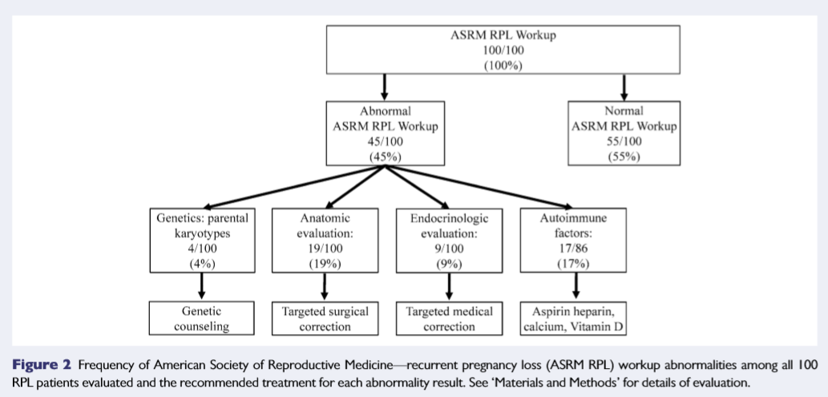
RPL ASRM
Notes:
ASRM ye göre 100 hastanın 45 inde temel RPL değerlendirmesinde problem var

